Slide 1

Ericsson Video Storage and processing Platform Introduction basics of the platform

Slide 2

agenda
Introduction to VSPP
VSPP Components
Looking at the Manager
What is a POD?
Recording Features
CloudDVR
Rolling Buffers
A tour of the GUI
API
Using the API to drive recordings
Using the API to perform Playouts
Diagnostics
Monitoring using the diagnostics Server
Quick look at Graphite
Looking at logging

Slide 3

An introduction to VSPP

Slide 4

Challenges
Streaming Capacity
Multiscreen
Library growth
Live to VOD
Storage

Slide 5
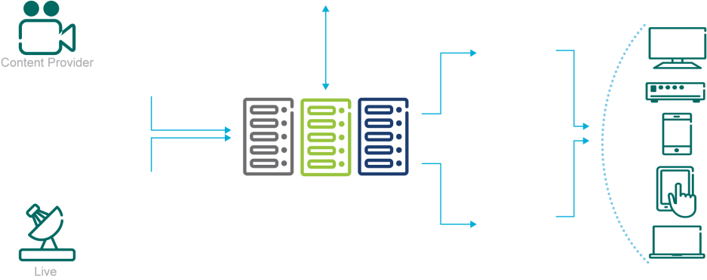
Typical video infrastructure implementation
Video Transcoding
Server Farm
Offline Content
Acquisition
UDP Video
Streaming Server Farm
Live Video Ingest
Server Farm
ABR Video
Streaming Server Farm
STORAGE levels

Slide 6
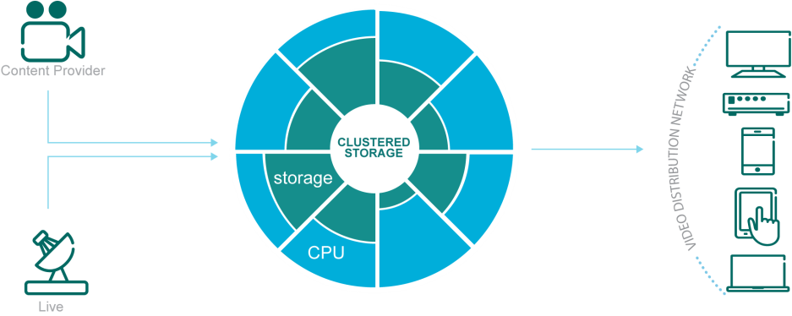
Ericsson Approach
Video Transcoding
Server Farm
Offline Content
Acquisition
UDP Video
Streaming Server Farm
Live Video Ingest
Server Farm
Integrate storage server silos into one virtualized CPU
ABR Video
Streaming Server Farm

Slide 7
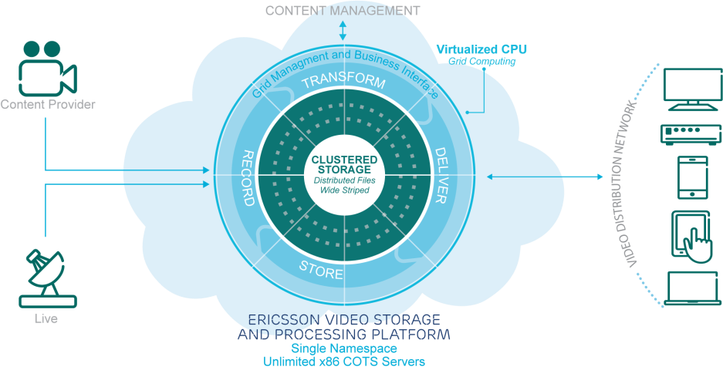
Ericsson Approach

Slide 8
How is VSPP different?
Ericsson VSPP
Video Storage and Processing Platform
COMPETITION
RACK OF INDIVIDUAL SERVERS
ASSET #1
ASSET #3
ASSET #1
ASSET #2
ASSET #3
ASSET #2
VSPP
VSPP | COMPETITIVE SOLUTION
Distributed File System - Recordings are distributed on all hard drives in the cluster | Relies on HW RAID controller Recordings are stored on individual servers
High performance – Our file system fully control disk access, block size for increased performance | Lower performance due to HW RAID controller one size fits all configuration
Server protection – Our distributed RAID - Recordings are accessible from any server in the cluster | No server protection – On server failure, recordings on the specific server are unavailable

Slide 9
Optimized for media storage and delivery
High Performance Clustered Storage
Incoming Video
Video Delivery from storage to downstream client
Grid Management and Business Interfaces
No Single Point Of Failure
Disk or machine failure – no missing data
Fully resilient
Maintenance keeps cluster healthy and balanced.
10 GbE Storage Nodes Interconnect
Notes:
9

Slide 10
Components

Slide 11
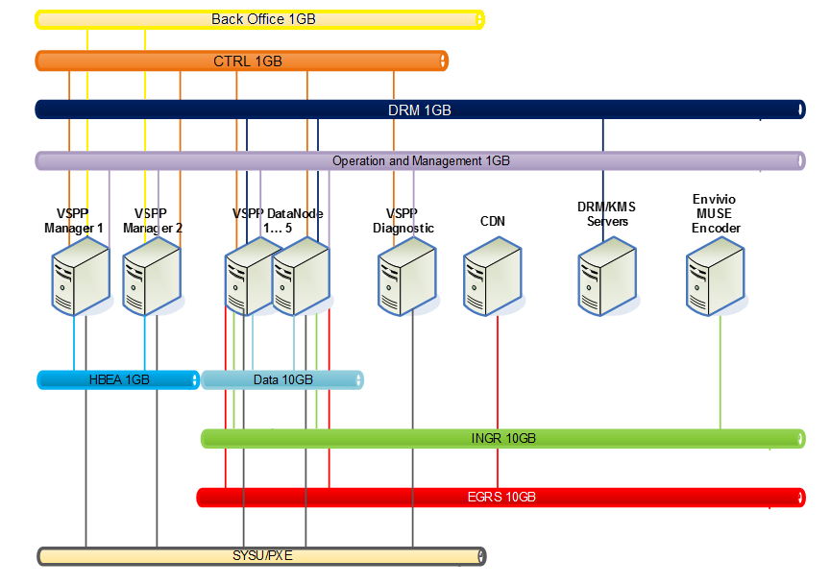

Slide 12
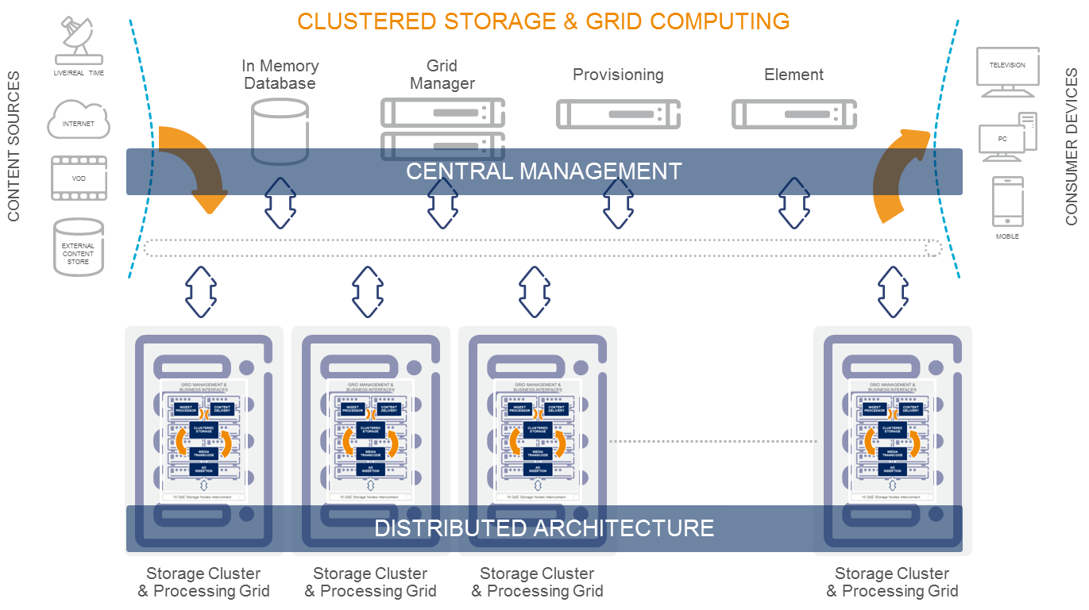
Cluster Manager
Expose Interface for cluster configuration
Connected to Database for cluster meta data
Keep HELLO handshake with all Cluster Servers
Perform background maintenance operation on the cluster
Rebuild
Restripe
Balance
Responsible for files creation/deletion and read/write permission
Download File System configuration to the Storage Servers

Slide 13
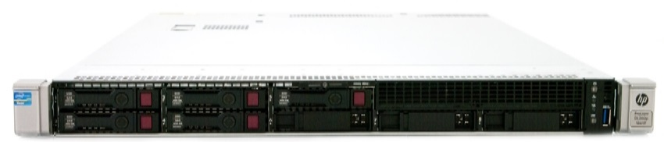
VSPP- Components
The VSPP Manager Server is an application server that controls and orchestrates the entire set of processes.
It dynamically controls and load balances the virtual video server clusters (pods) in a real-time environment in terms of storage capacity allocation, content processing capabilities, ingest and streaming throughput.
In addition to managing the pods, the VSPP Manager communicates with the operator Back Office (BO) infrastructure using multiple interfaces. (APIs)
EXAMPLE HARDWARE
2 x HP ProLiant DL360/G9 servers
6 SFF SAS disks per node
300GB per disk
No 10Ge dual port cards required

Slide 14


VSPP- Components
High Availability Controller
SolidDB: An in-memory database system that delivers high speed performance and provides extremely fast access to critical configuration and service data of the Video software layer.
HSB API
SolidDB: may scale to hundreds of thousands of transactions per second, thereby reducing latency in the overall cDVR system functionality.
Primary server,
Secondary server, node 2
node 1
HSB
Database
Database
Solid was acquired by IBM in 2007. It was subsequently sold to UNICOM Global in 2014.

Slide 15
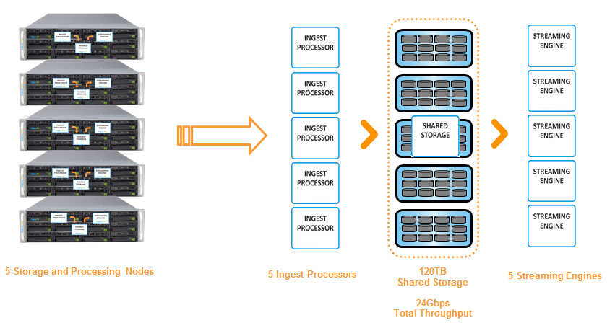
Storage cluster
Storage Server is an Intel-based server, each server can support any number of disks
Handle configuration commands from Cluster Manager
Manipulates data upon requests from Storage Clients
Advanced data caching for better performance
Collects statistics

Slide 16
VSPP- Components
Nodes
Nodes are hardware and software components that are responsible for both storing and streaming the videos.
Each Pod is comprised of one or more Nodes. Each Node has disks and processing power. Collectively, the Nodes of a Pod provide its functionality.
The streaming software on each Node delivers the content from the storage volumes of the Node to the end-user devices.
Nodes are also responsible for recording broadcast channels and for ingesting VOD Assets.

Slide 17
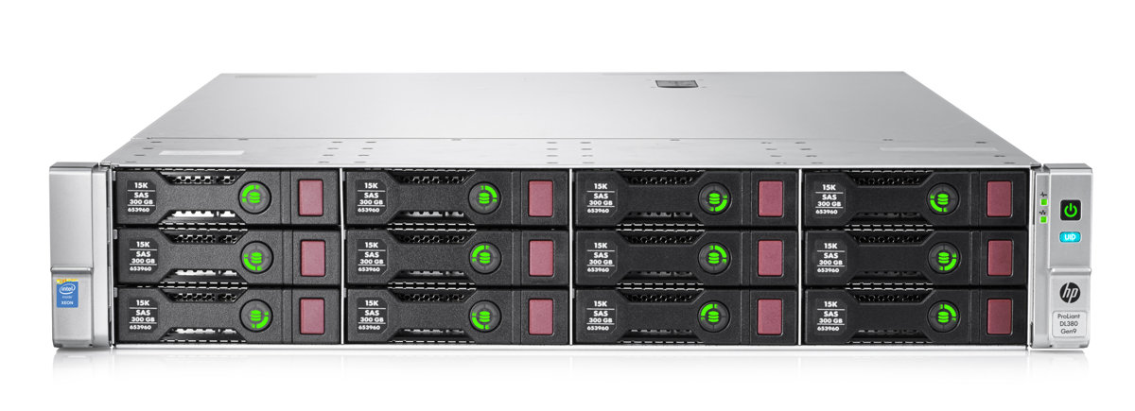
Example pod nodes
HP ProLiant DL380/G9 servers
14 LFF SATA disks per node
4TB per disk
12 in the front 2 in rear
10Ge dual port cards

Slide 18
VSPP- Components
Pods
Pods are the basic logical building blocks of the system.
Each Pod is comprised of one or more Nodes, with each Node containing one or more disk drives.
The disk (storage) resources of all the combined Nodes are shared within a Pod as required.
Each Pod runs a video ingest streaming process and can handle numerous sessions (video streams) simultaneously.
VSPP
VSPP
Linux OS
Linux OS
VSPP
VSPP
Linux OS
CLUSTERED STORAGE
Linux OS
VSPP
VSPP
Linux OS
10 GbE Storage Nodes Interconnect
Linux OS
VSPP
VSPP
Linux OS
Linux OS
VSPP
VSPP
Linux OS
Linux OS
VSPP
VSPP
Linux OS
Linux OS

Slide 19
VSPP Storage and Compute Grid
Generally, a single pod scale is limited by the interconnection network bandwidth.
A full mesh high throughput interconnection is required between all the nodes in a pod: in order to transfer the dispersed chunks of the data on the fly during ingest or streaming.

Slide 20
System Architecture
The VSPP systems cluster could be divided into two node types -
Stateful node - A node where the operating system is installed on the local hard drive, at Ericsson those nodes are referred as management nodes.
Stateless node - A node where the operating system is packed into an image (archived cpio in bz2/gz format) which is downloaded at boot time and extracted to an area of the memory which is used as file system, at Ericsson those nodes are referred as data nodes

Slide 21
System Architecture
Ericsson Applications are divided into 2 types.
Management applications – Manager, Scheduler, syspu, Gui, Database, and RTSP Plugin. Those applications are installed on management node due the need of operating system with persist data saved.
Non-management applications – Streamer, Storage, FTP/NAS, and Transcoder. Those applications are installed on stateless nodes and does not require operation system persist data and all the configurations are pulled from the manager application using HTTP.
This layout allows to save all the video data on the stateless nodes disks disabling the need to some special storage hardware.

Slide 22

Use Cases

Slide 23
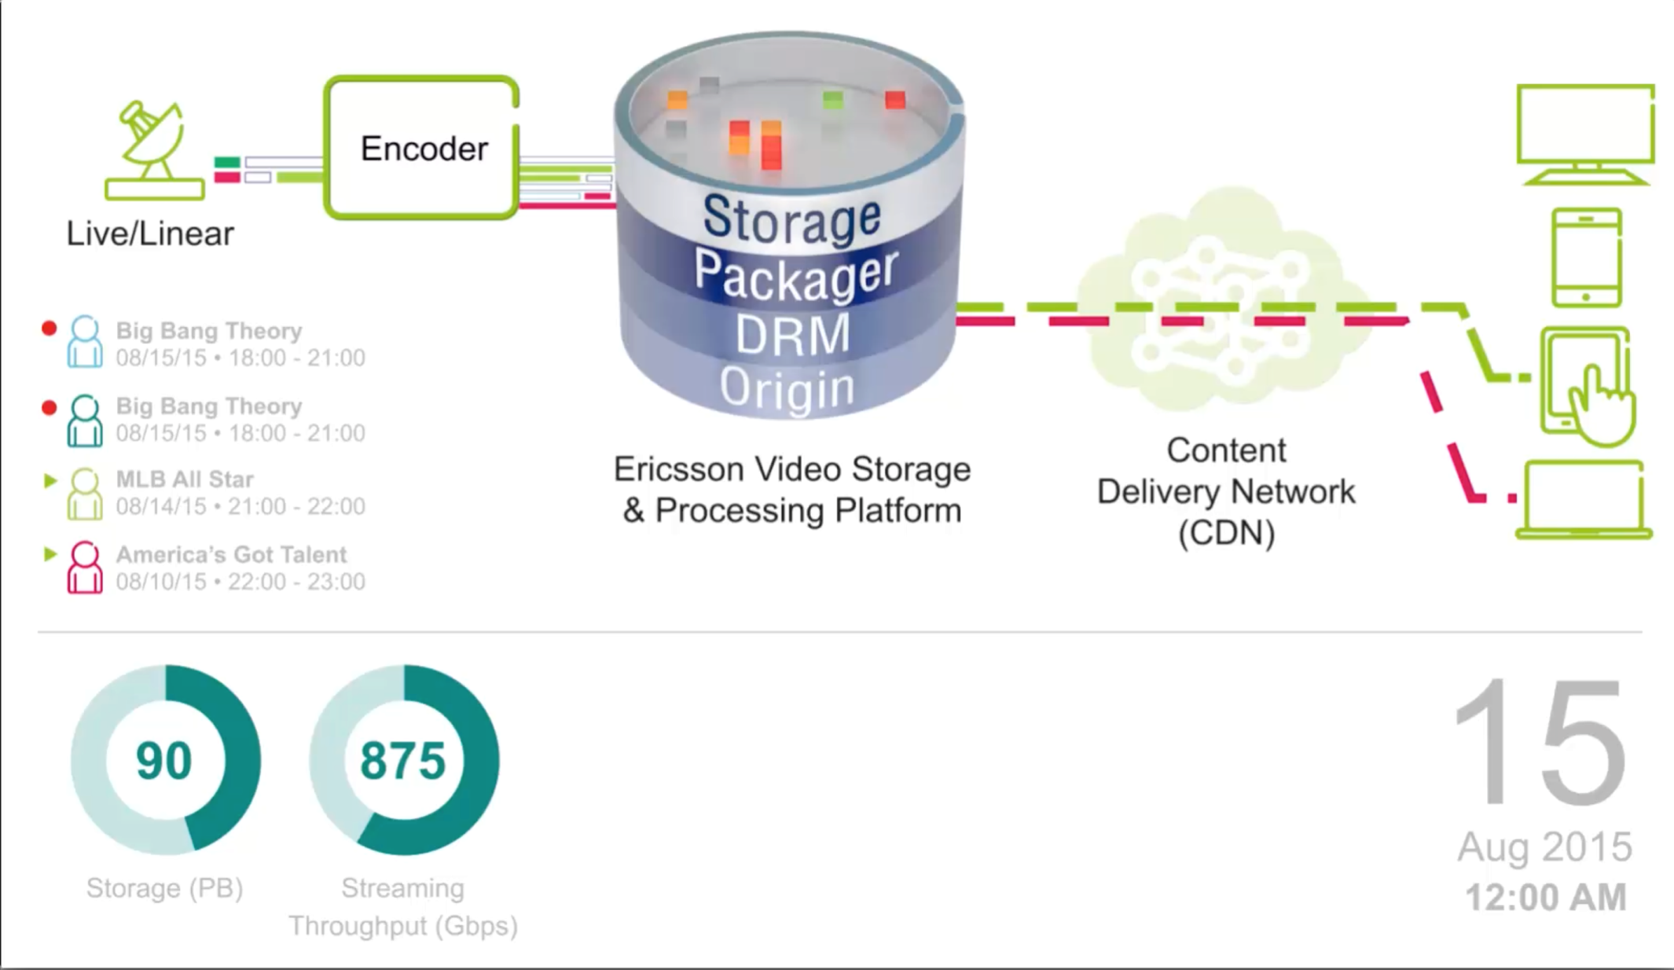
Private Copy Cloud DVR

Slide 24
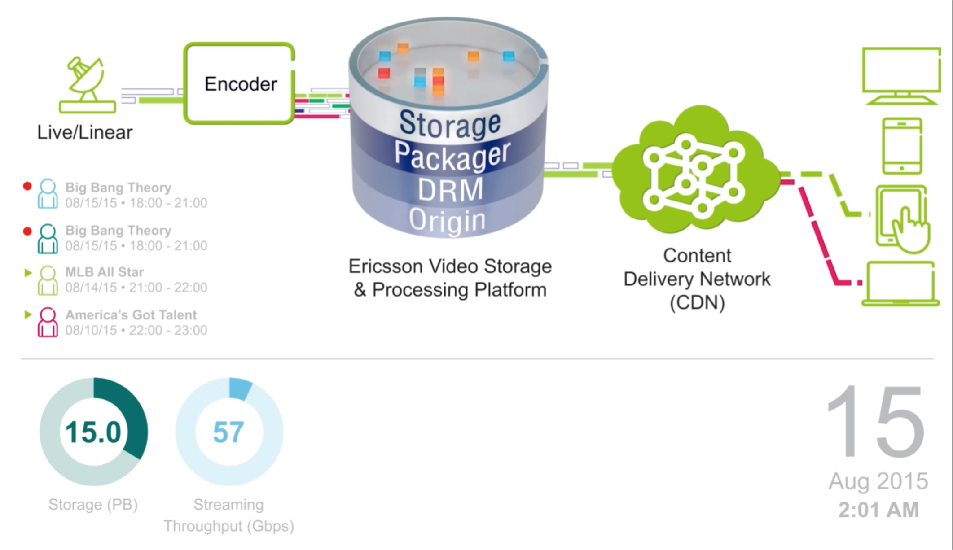
Shared Copy Cloud DVR

Slide 25
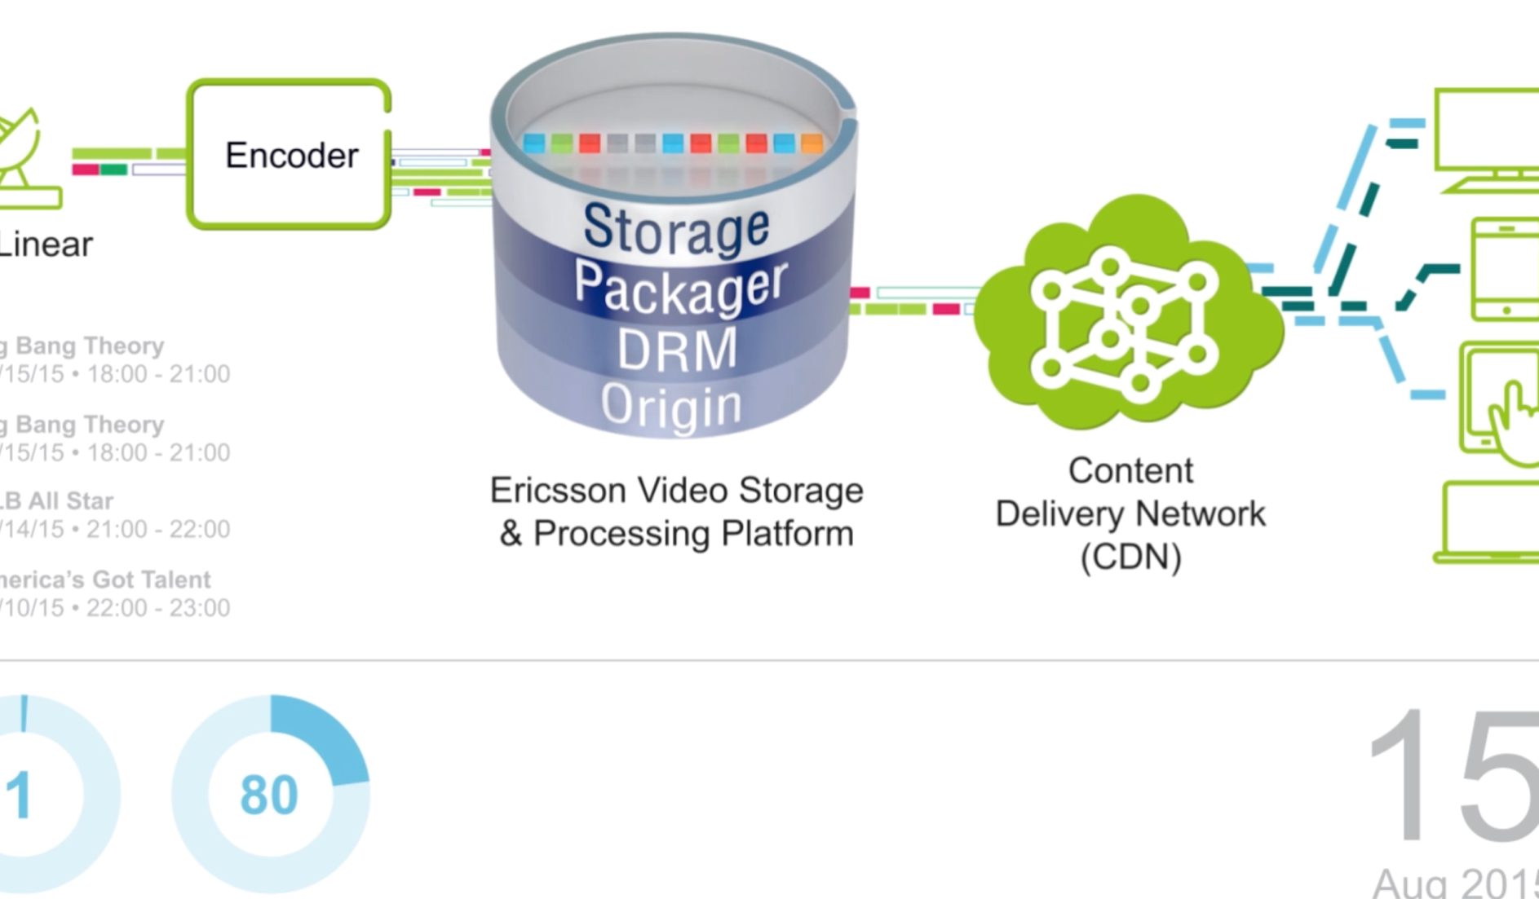
Time shifted TV

Slide 26
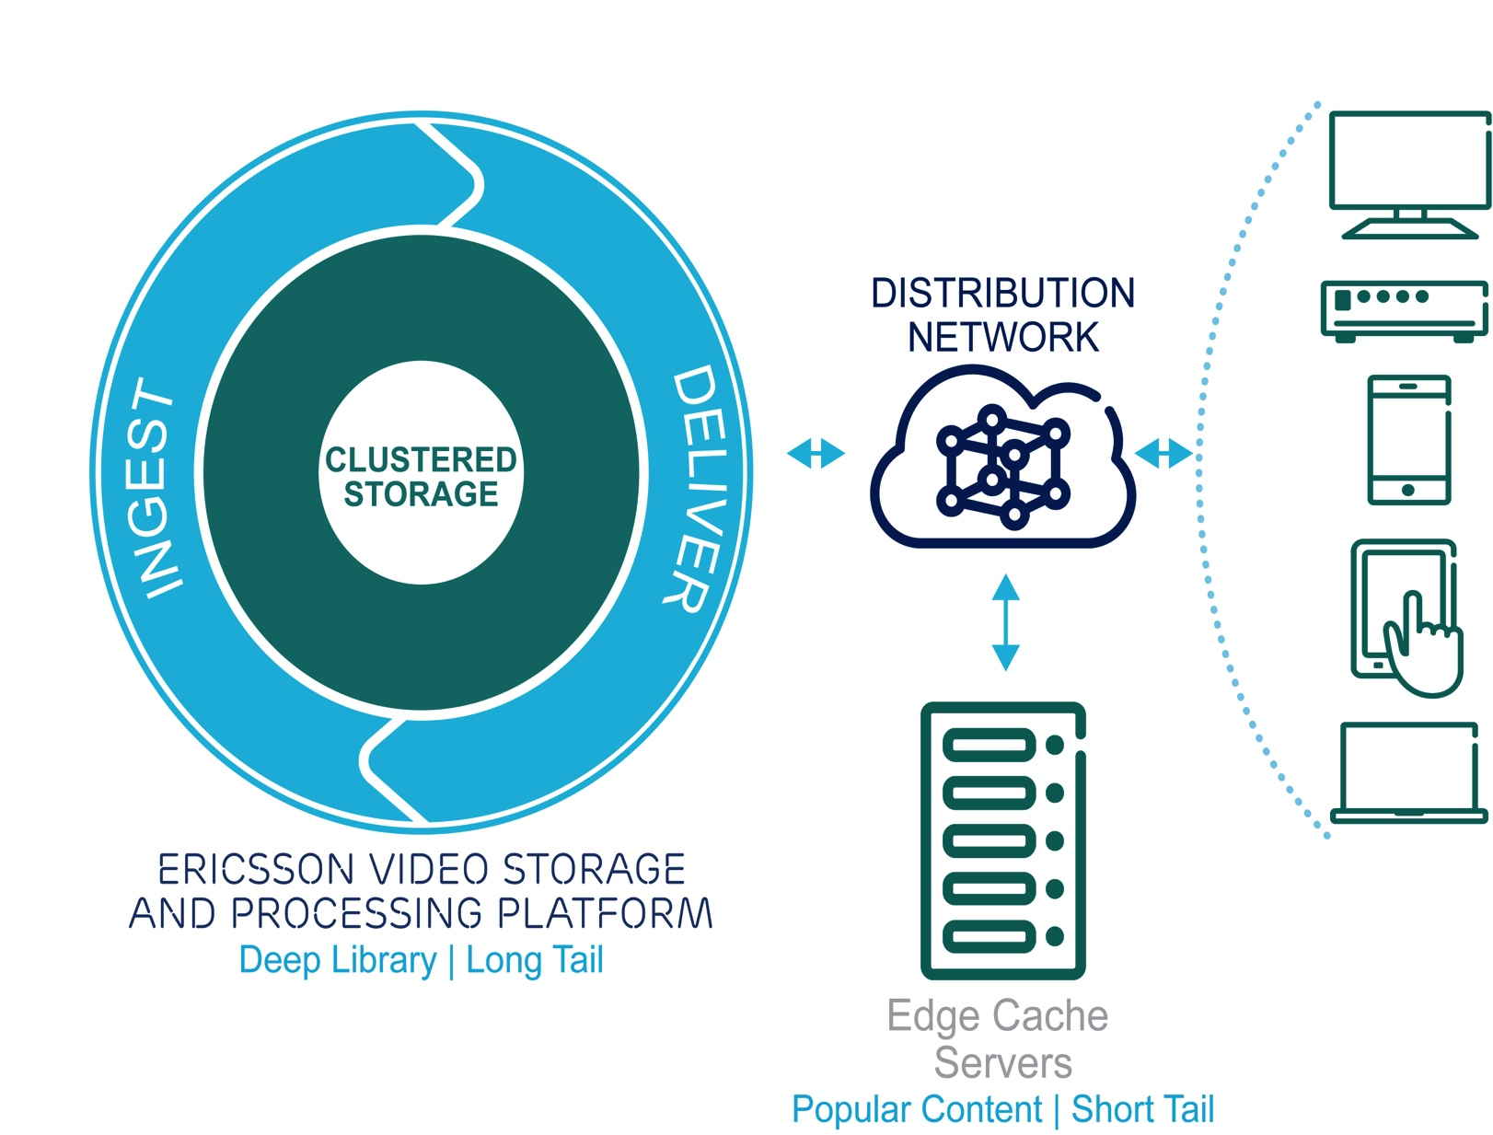
Long Tail Video Server Optimize your network

Slide 27
The ingest process

Slide 28
Ingest
The first stage of video streaming is fetching the data and saving it in our clustered storage. We call this stage ingest.
The input streams are either MPEG-TS video stream or converted into MPEG-TS video stream before saved.
For allowing random access and other special functionality, the streamer parse and save an index during the ingest.
The resulting files at the end of the ingest are the video stream file with the mpg extension and the two index files with the fx/mfx extensions.

Slide 29
VSPP INGEST PROCESS
Video Analyzing for Index File Generation
During the ingest of the content, whether a VoD file on an FTP server or a live program recorded from the encoder using IP multicast, the manager creates index files. These files describe the structure of the ingested asset.
The index files later enable the cDVR to perform time optimized random access to any point in the recorded asset, according to the subscriber device request, and also to create trick play modes during the streaming of the asset.
The trick play modes are generated on-the-fly without using pre-generated “trick files”, thus can create any requested scale without adding storage overhead.

Slide 30
INGEST
VOD sources – FTP/HTTP/FS MP4 and MPEG-TS
Live Sources - SPTS MPEG-TS Multicast (IGMP V2/V3)
Video - MPEG-2/H.264/HEVC Video
Audio - MPEG audio/AAC-LC/AAC-HE/AC3
Subtitles/CC

Slide 31
Features: Recording, Processes while Ingest
INGEST PROCESSES | NAME
VSPP performs several processes while ingesting a video | Description:
To prepare the video, check quality and improve for later use (stream). Indexing: Video analyzing and creation of index file per each ingested SPTS. Error detection: Performing Video and MPEG Transport Stream level integrity check and errors detection. Prepare for ad-insertion: Detection of SCTE-35 markers for seamless Ad-insertion and splicing purposes. Null packets removal from the TS for storage capacity efficiency. Original PIDs remapping to the common values. Segmenting and dispersion of the content across the entire cluster | Main Purpose

Slide 32
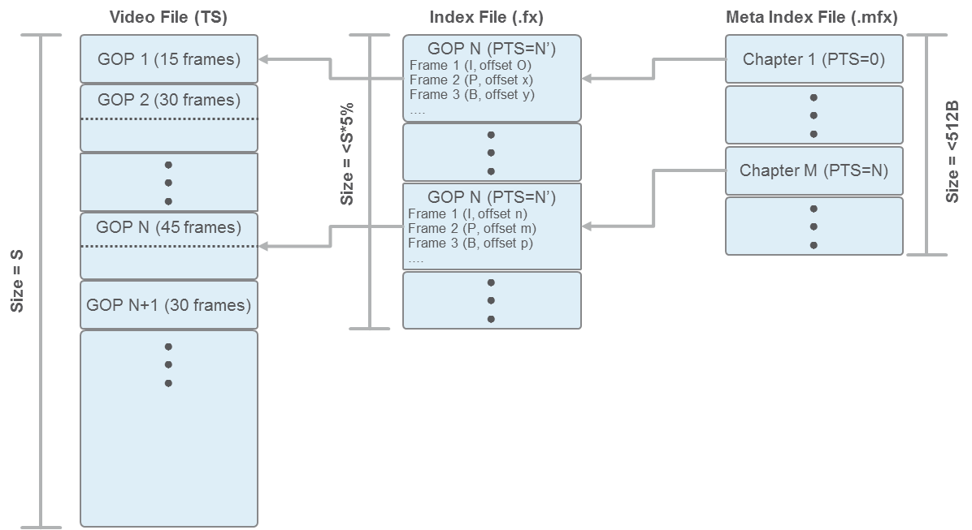
Features: Recording, Processes while Ingest

Slide 33
VSPP Storage and Compute Grid
As a final point in the ingest process the content is optionally
segmented to small chunks (~1MB) and dispersed across the entire
cluster to provide better storage capacity efficient and ensure the
highest reliability level and most advanced content redundancy
scheme.
Fabrix Mega
1,155,072 Bytes
188
(MPEG2 TS packet size)

Slide 34
streaming

Slide 35
What is abr?
OTT
OTT services for companion devices are served only from the Origin servers.
Manifests and segments of the ABR protocols are tunnelling through the CDN and built in a way that can be cached on CDN nodes and reduce throughput from the Origin.
OTT protocols in use are:
HLS (Apple HTTP Live Streaming)
HSS (Microsoft Smooth Streaming)
DASH Dynamic Adaptive Streaming over HTTP

Slide 36
OTT packaging
Packaging Protocols:
HLS
Microsoft Smooth Streaming
MPEG-DASH (ISOBMF)
Video:
H264
H265 with MPEG-DASH
Audio:
AAC

Slide 37

HLS
HLSv3
single audio embedded in the segment
HLSv4
optimal alternate audio (as AAC es, or MPEG2-TS)
HLSv5
Iframe manifests support
WebVTT Subtitles
AES-128-CBC encryption
HLS Sample Encryption (HLSv5+)

Slide 38
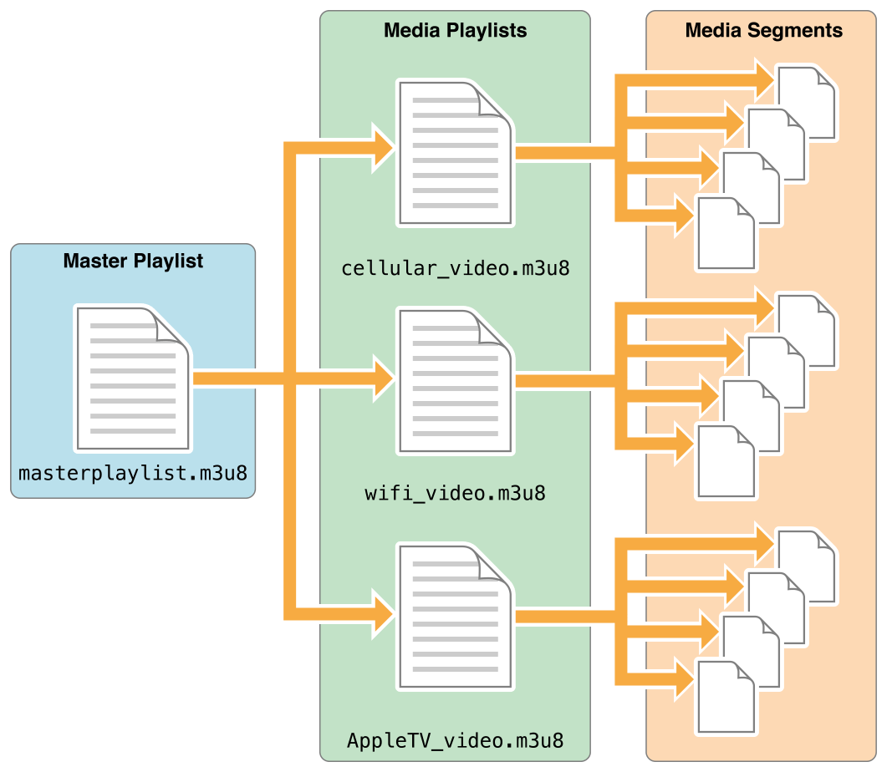
HLS Manifests

Slide 39
HLS Variant Manifest (Top Level)
#EXTM3U
#EXT-X-VERSION:5
#EXT-X-STREAM-INF:PROGRAM-ID=1,BANDWIDTH=713008,RESOLUTION=320x240
IGAAAAAABAENBCDF.m3u8/Level(1)
#EXT-X-I-FRAME-STREAM-INF:PROGRAM-ID=1,BANDWIDTH=110102,URI="IGAAAAAABAENBCDF.m3u8/Iframe(1)"
#EXT-X-STREAM-INF:PROGRAM-ID=1,BANDWIDTH=963005,RESOLUTION=448x336
IGAAAAAABAENBCDF.m3u8/Level(2)
#EXT-X-I-FRAME-STREAM-INF:PROGRAM-ID=1,BANDWIDTH=141101,URI="IGAAAAAABAENBCDF.m3u8/Iframe(2)"
#EXT-X-STREAM-INF:PROGRAM-ID=1,BANDWIDTH=2295015,RESOLUTION=640x480
IGAAAAAABAENBCDF.m3u8/Level(3)
#EXT-X-I-FRAME-STREAM-INF:PROGRAM-ID=1,BANDWIDTH=239571,URI="IGAAAAAABAENBCDF.m3u8/Iframe(3)"
#EXT-X-STREAM-INF:PROGRAM-ID=1,BANDWIDTH=96000
IGAAAAAABAENBCDF.m3u8/Level(4)

Slide 40
HLS Level Manifest
#EXTM3U
#EXT-X-VERSION:3
#EXT-X-TARGETDURATION:5
#EXT-X-PROGRAM-DATE-TIME:2013-12-07T21:17:00
#EXT-X-MEDIA-SEQUENCE:0
#EXT-X-KEY:METHOD=AES-128,URI="http://83.174.61.245:80/encrypted_hls_static_key"
#EXTINF:4,
Level(1)/Segment(0).ts
#EXTINF:4,
Level(1)/Segment(1).ts
#EXTINF:4,
Level(1)/Segment(2).ts
#EXTINF:4,
Level(1)/Segment(3).ts
#EXTINF:4,
Level(1)/Segment(4).ts
#EXTINF:4,
Level(1)/Segment(5).ts
#EXT-X-ENDLIST

Slide 41
Smooth streaming
ISOBMF fragmented mp4
AAC audio (multiple streams)
Supporting multiple audio streams
Supporting TTML subtitles
PlayReady
AES-128-CTR sample based encryption

Slide 42
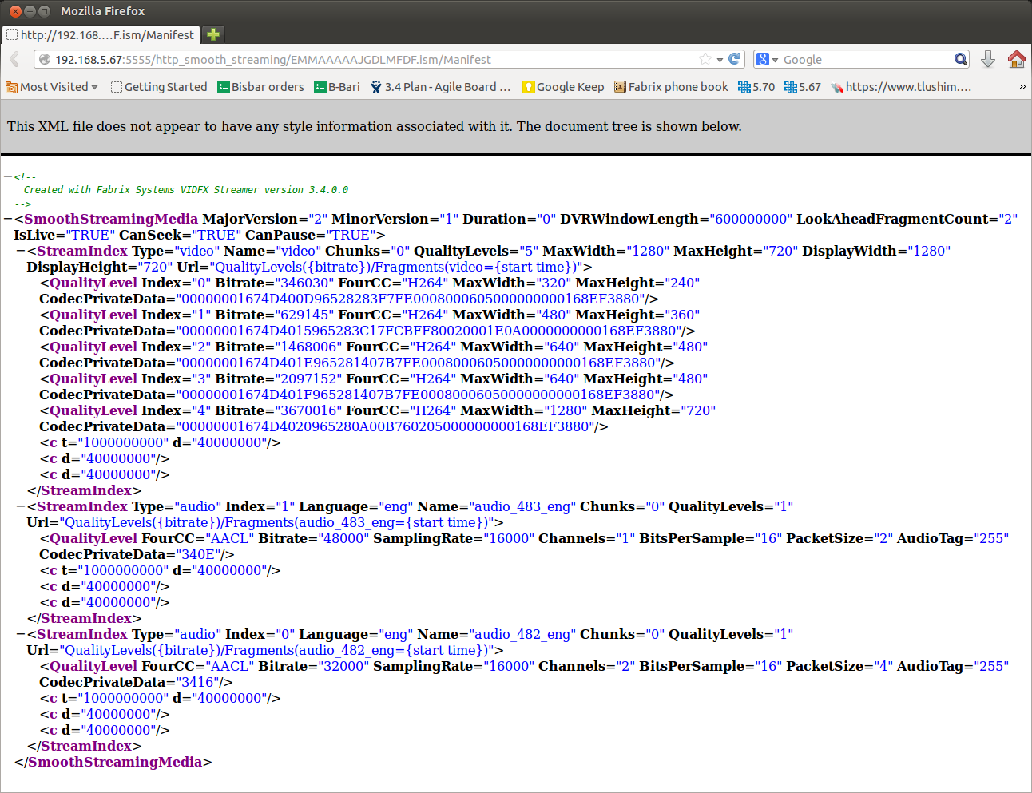
MSS (smooth) Manifest

Slide 43
MPEG-DASH
ISOBMF fragmented mp4
AAC audio (multiple streams)
Supporting H265(hevc) packaging
Subtitles:
TTML for textual subtitles
SMPTE-TT for image based subtitles (bitmaps)
CENC encryption (AES-128-CTR sample based encryption)
PlayReady and WideVine
Supporting multi DRM packaged stream

Slide 44
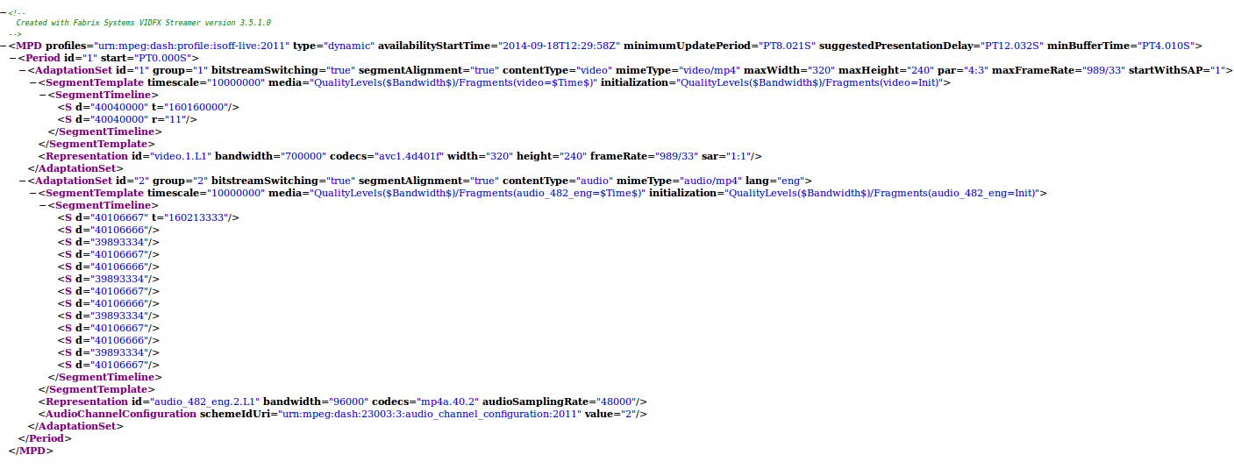
MPEG-DASH Manifest

Slide 45
VSPP Streamer
Streamer
Playout
ingest
Packaged
Segment
Packaging
+Encryption
Segmentation
Indexing
Indexing
Indexing
TS Source
CBR Playout
Indexing
CBR Streaming
Storage Client

Slide 46
segmentation
IDR every 2 seconds
IDR
IDR
IDR
IDR
IDR
IDR
IDR
IDR
IDR
IDR
2Mb/s
1Mb/s
0.5Mb/s

Slide 47

DRM - How it is done?
VSPP
DRM Key provider
2. Key Request
3. DRM info (key data)
with data for the client
Client license
acquisition
server
4. Manifest with DRM data
(e.g. license acquisition URL & key ID)
1. Session Allocation / Manifest request
5.1. Decryption
Key Request
6. Decryption Key
5.2 Encrypted Segment

Slide 48
Traditional OTT system
HLS
HLS
Packager
HLS Streaming
Smooth Streaming
Smooth Streaming
Smooth
Packager
HTTP Server
MPEG-DASH
DASH
Packager
DASH Streaming

Slide 49
VSPP using jitp
HLS Streaming
VSPP Storage
Encoder
MBR TS
Smooth Streaming
Just In Time Packaging
HTTP Server
DASH Streaming

Slide 50
Features: On the fly media processing
The VSPP offers an out of the box integration with a number of leading DRM vendors:
Verimatrix PlayReady for HSS/HLS
Irdeto PlayReady for HSS/HLS
BuyDRM
Cisco (NDS)
Nagra
Latens
Ericsson uses the standard OpenSSL library to implement various encryption algorithms as defined by any ABR/DRM streaming specifications:
HLS: AES-128 CBC encryption
HSS: AES-128 CTR encryption
50

Slide 51
Recording features of vspp

Slide 52
Features: Recording
RECORDING | NAME
Basic functionality by which the Manager is requested to record a video. The manager allocate a node and sends a record request for a streamer process | Description:
Enables recording based on Time based, recording splits into 2 types: user driven and operator driven User driven includes cDVR recording (time-based or EPG) Operator driven is rolling buffer | Main Purpose

Slide 53
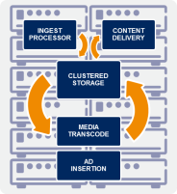
Features: Recording, Time Based
TIME BASED RECORDING | NAME
Basic functionality by which the Manager is requested to record a video based on time boundaries (channel, start time, end time) | Description:
To record an asset based on time (channel, start time, end time), used by Manager (no EPG awareness). | Main Purpose
Record
CMS
STB
Record
Tablet
Record
Record Batch Programs
Record
PC
Record
Record
VSPP
Multiple recording requests
Aggregated record command

Slide 54
Features: ROLLING buffer
TIME SHIFT BUFFER | NAME
Operator-driven automatic recording feature | Description:
To allow for “Catch-Up TV”, “Start Over”, “Record In The Past”, and other features, all live broadcast channels in the line-up are automatically recorded by the cDVR, stored, and made available for all subscribers during a predefined time-based sliding window called Time Shift Buffer (TSB). | Main Purpose

Slide 55
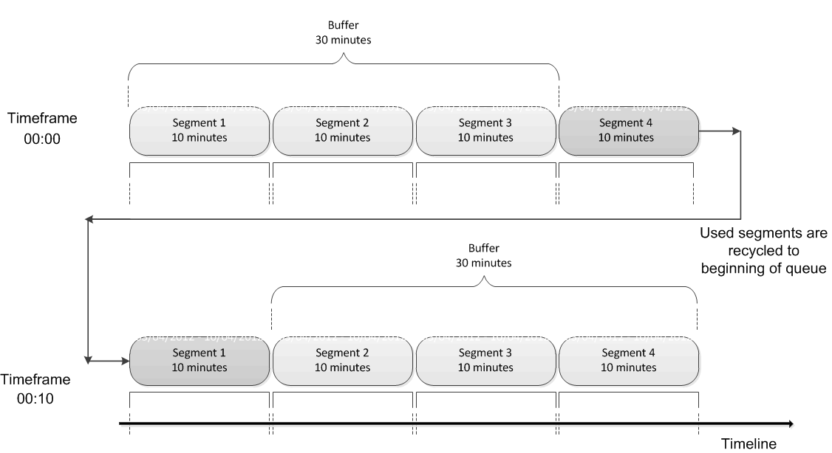
Features: ROLLING buffer

Slide 56
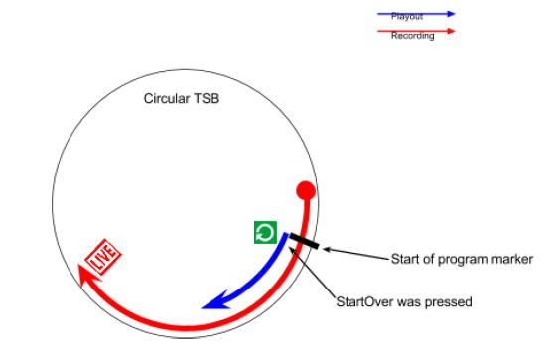
Rolling Buffers

Slide 57
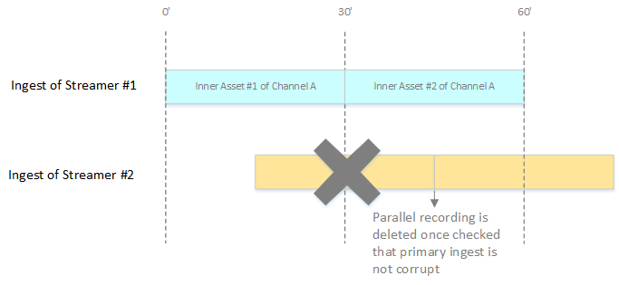
Live stream resilience
If using the option to ingest the live stream to two streamers this will cause VSPP to compare the two recordings and to reject that which is lowest quality.
If both recordings are of the same quality then one is selected to be removed.

Slide 58
GUI

Slide 59
GUI Overview
- Region, Pods, Streamers
Sessions view
Streamer Networks
Region and Streamers Properties. Configuration Editor
- Volume and Disks
- Storage jobs: rebuild, restripe, repair, balance, disk utilities
- Applications Tab
- Administration Tab
Channels Map: adding and viewing channels properties
Profiles
Security
- Monitoring Tab
Sessions Dashboard
- Search Tab

Slide 60
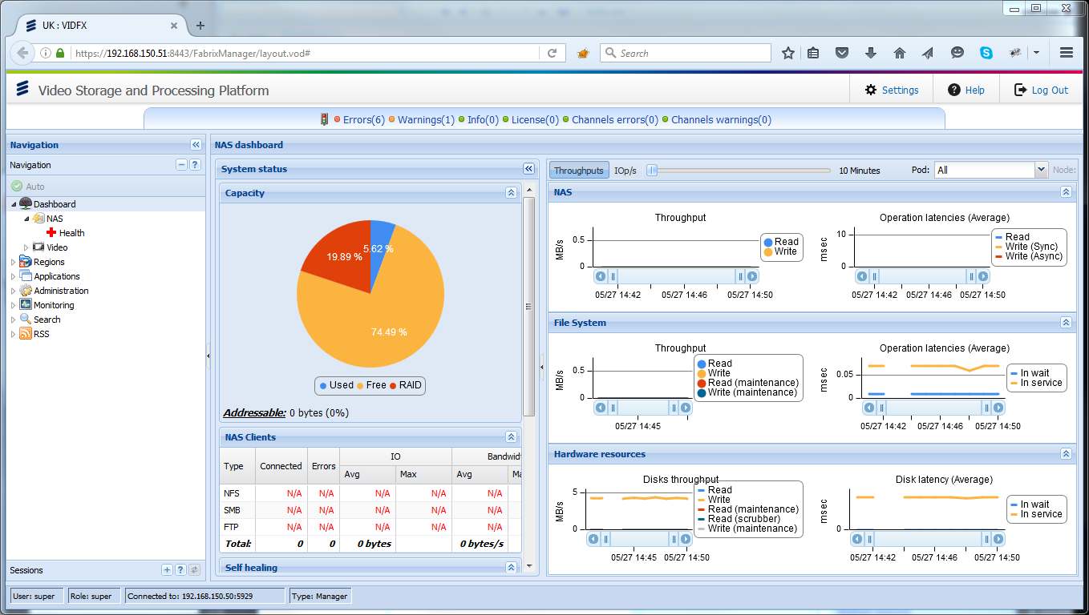
VSPP manager GUI
https://mgr-vip:8443

Slide 61
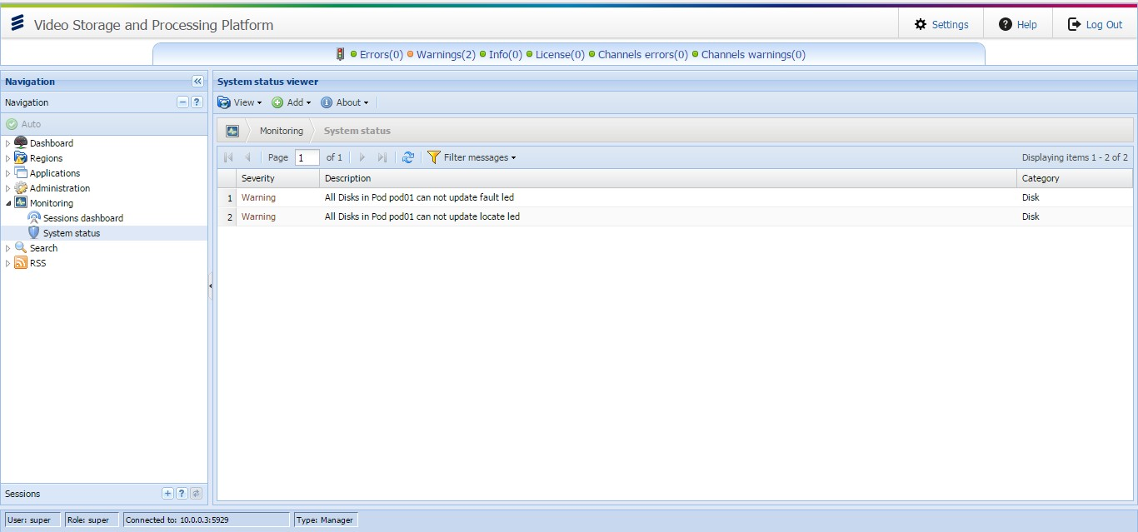
VSPP Manager GUI – System STATUS

Slide 62
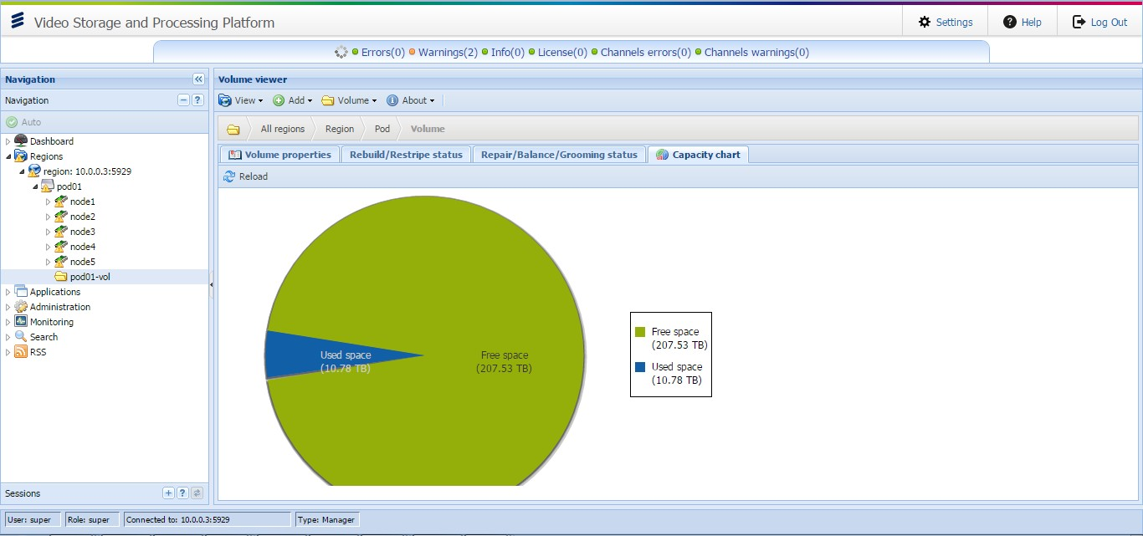
VSPP Manager GUI – SYSTEM VOLUME

Slide 63
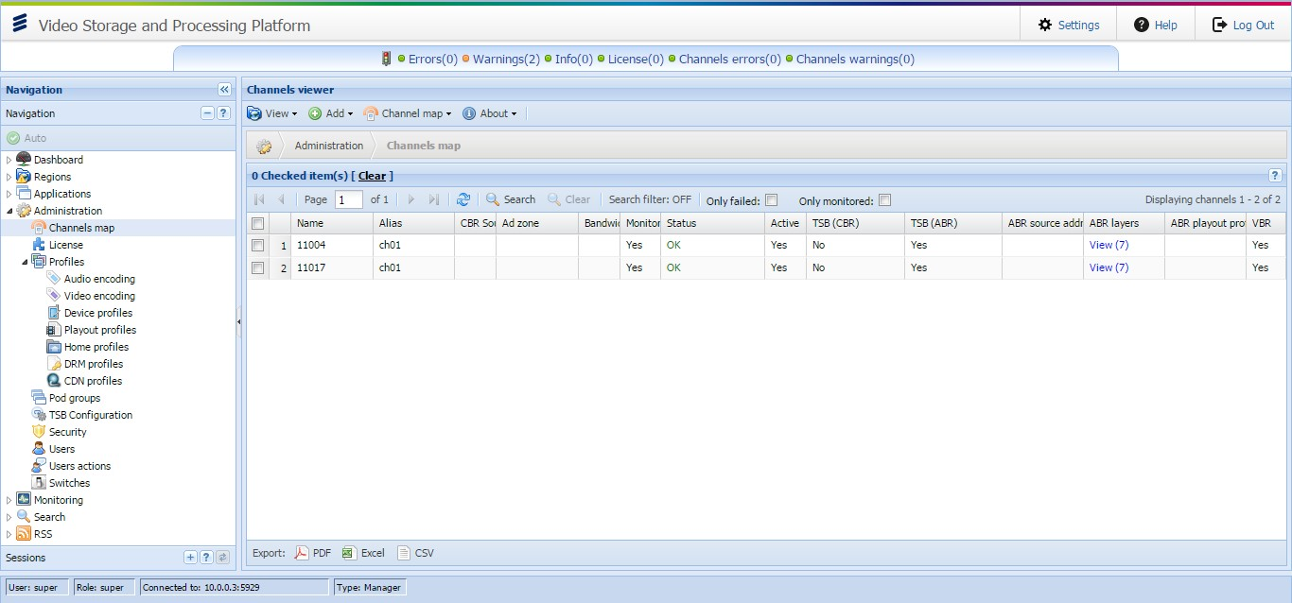
VSPP Manager GUI – CHANNELS

Slide 64
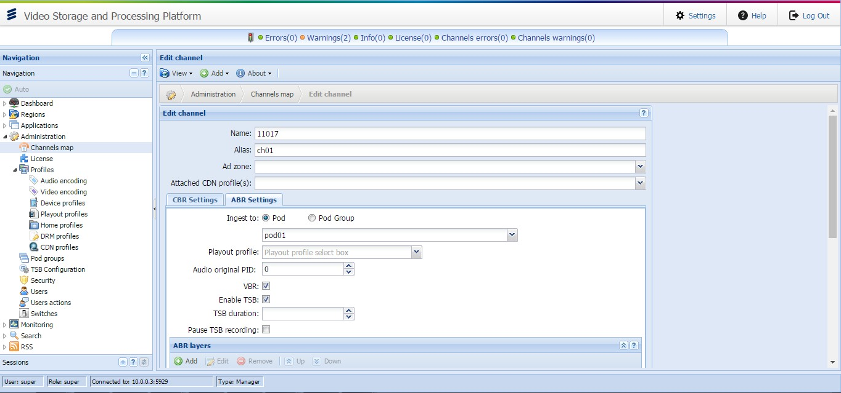
VSPP Manager GUI – CHANNELS

Slide 65
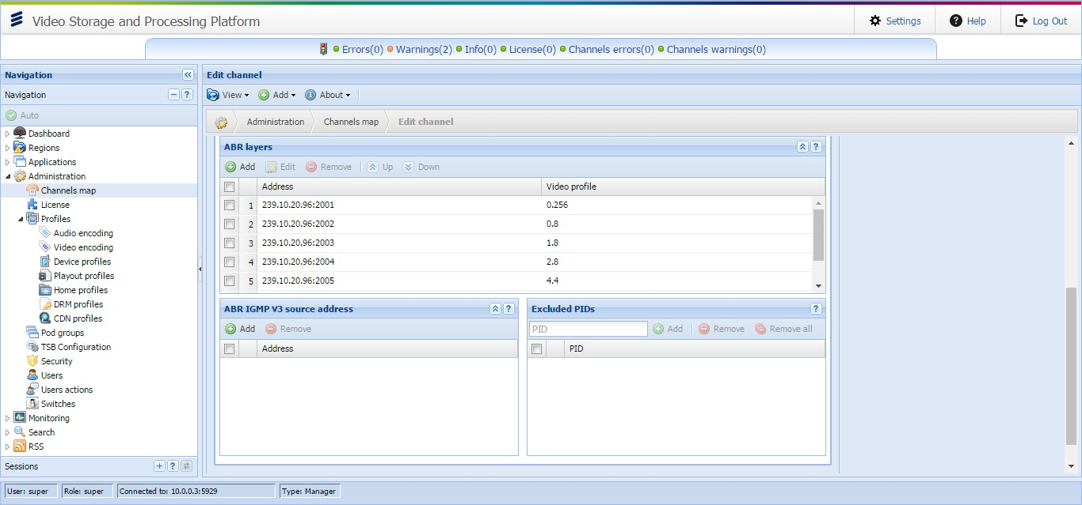
VSPP Manager GUI – CHANNELS

Slide 66
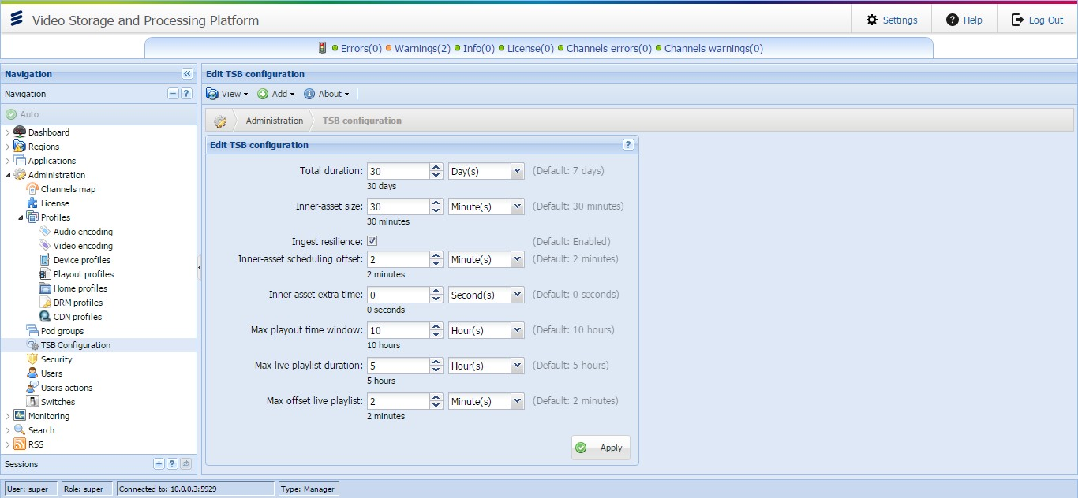
VSPP Manager GUI – ROLLING BUFFER

Slide 67
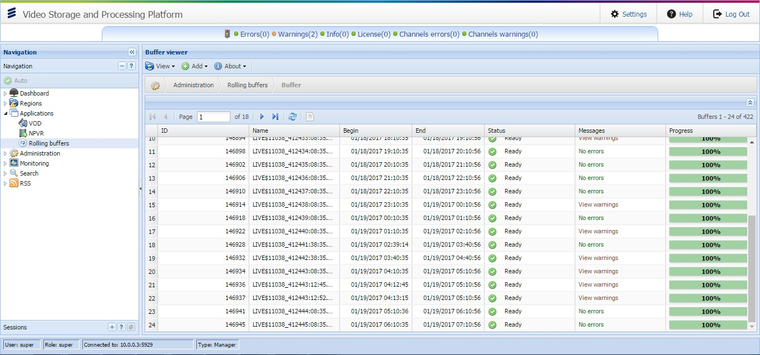
VSPP Manager GUI – ROLLING BUFFER

Slide 68
Profiles
Audio and Video Profiles:
- Match a bit rate for input layers of channels
- Are used for Ingest
- Are used for Playout
Device Profiles:
- Have different types according to streaming type
- Default profiles can be used only by some simple checks
Custom profiles should be created according to client devices and used in production

Slide 69
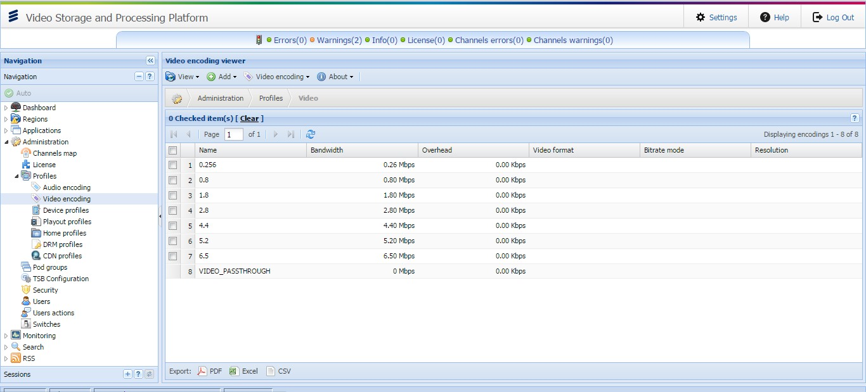
VSPP Manager GUI – VIDEO PROFILES

Slide 70
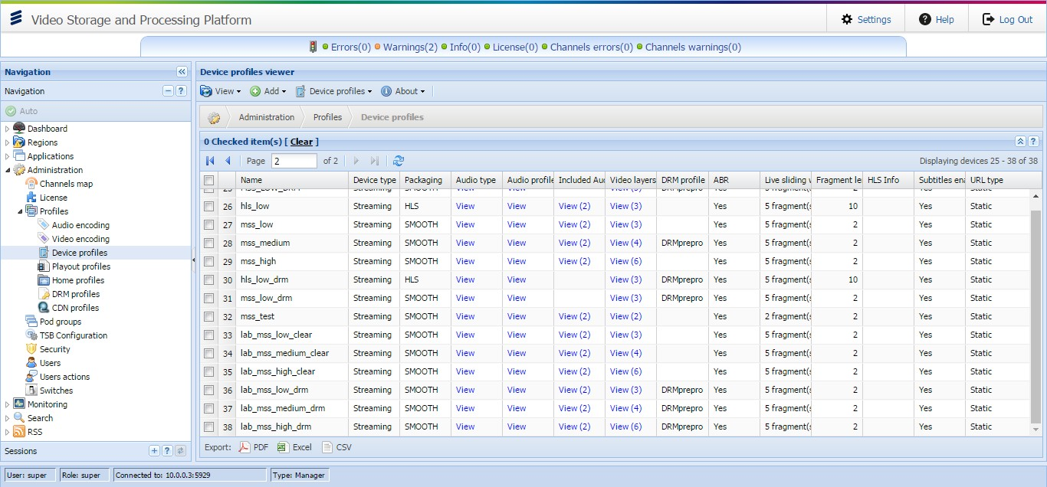
VSPP Manager GUI – DEVICE PROFILE

Slide 71
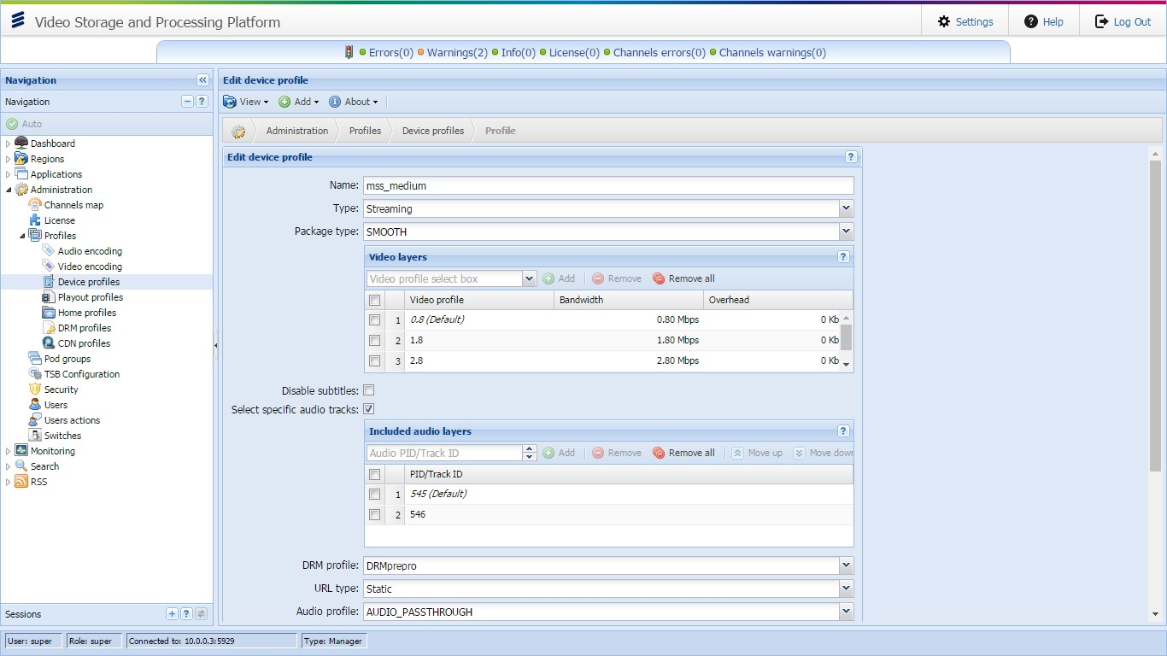

Slide 72
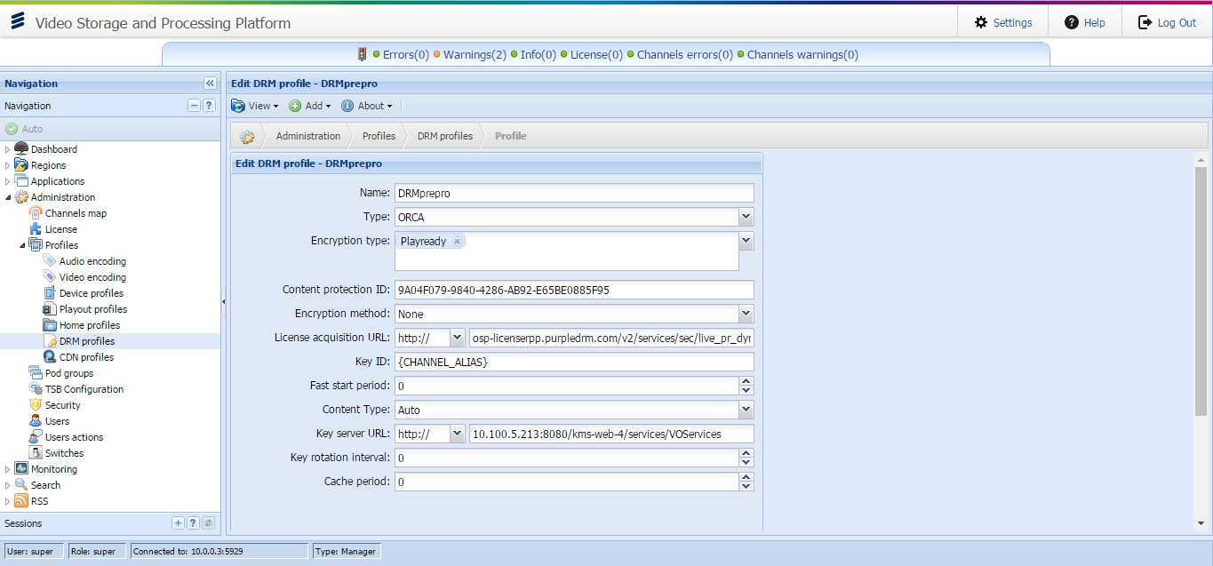
VSPP Manager GUI – DRM PROFILE

Slide 73
VSPP APIs

Slide 74
APIs
Time-Based Recording Management API | Name:
This API exposes a set of commands that assist to initiate programs recordings request and manage the recording data based on time. Recording command can be sent to Scheduler or Manager. The cDVR will receive from the CMS/3rd party Scheduler applications a "ShowingID" attribute as an external content identifier for the schedule recordings and recordings management requests | Description:
To allow operations such as: | Main Purpose
Methods | Scheduler | VSPP Manager
ScheduleRecording | X | X
UpdateRecordingsTime | X | X
StopRecording | X | X
DeleteRecordings | X | X
BookMarkRecording | X
GetRecordingBookmark | X
ProtectRecording | X
StartPauseLive |  | X
StopPauseLive |  | X
SetRecordingMetadata | X
GetRecordingMetadata | X
GetSubscriberRecordingsList | X | X
GetRecordingDetails | X | X
SearchForRecordings | X | X
GetRecordingPlayoutURL | X | X

Slide 75
APIs
Recording Notifications API | Name:
This API exposes a set of commands that report about the status (success/fail) once the recording completes. Such notifications are typically sent to the recording request originator or any other operator CMS/BO system. | Description:
To allow operations such as: RECORDING_COMPLETED RECORDING_LOST | Main Purpose

Slide 76
APIs
Cloud DVR ABR API Specifications | Name:
This API exposes a set of commands playout ABR video either at VOD or cDVR | Description:
To allow operations such as: Rolling Buffer - Dynamic Mode Rolling Buffer - Static URL RS-DVR Playout Request VOD Playout - Static URL VOD Playout - Dynamic URL MP4 Download Request Session Destroy Rolling Buffer Status Mixed Rolling Buffer Status | Main Purpose

Slide 77
APIs
Content Management API | Name:
Cloud DVR content management interface and encapsulates set of commands for external management of the content stored on the Cloud DVR storage grid (VOD files, live channels and rolling buffer recordings etc. | Description:
To allow operations such as: VOD - Create Asset Request Single File Delete Delete Multiple Files View VOD Files Search VOD Assets View Ingest Progress View Video Properties Fetch Playable ABR VOD Assets | Main Purpose

Slide 78
How does this work in practice?
Static URLs:
http://str.pod01:5555/shls/1234567/5.m3u8?device=HLS
Adding the MDN:
http://rr.ttg.tr/TTG/VOD/shls/1234567/5.m3u8?device=HLS
Playout API relies on the concept of device profiles
These are created in the UI and describe the capabilities of the client device making the request
VSPP uses this profile to determine what bitrates may be available to that device

Slide 79
VSPP Diagnostics

Slide 80
Main Concepts
Centralized architecture for the monitoring and diagnostics of the VSPP deployment
Provides a proactive view on the:
System performance and health
Service and application level monitoring and metrics
Business level analysis
Exposes the following diagnostic capabilities and tools:
Real-time monitoring
Dashboards: visualization and graphs
Analytics: raw data export and offline reports

Slide 81
Diagnostics - PRODUCT
Out of the box features identical for all customers
Real-time monitoring
Pre-defined real-time alerts with configurable thresholds (SNMP traps/emails)
SNMP monitoring (GET/WALK) for the seamless integration with deployed NMS
Video dashboard - fixed graphs with a basic service KPI’s as part of VSPP UI
Reporting services:
Raw data extraction for the offline analysis by external BI systems
Splunk reports: pre-defined by start-packs for different deployment cases

Slide 82
Real time Monitoring
SNMP Monitoring
Enables seamless integration with any NMS environment:
SNMP traps: real time system and service level alerts
SNMP counters: real time data based on system performance counters
Notifications
Flexible and configurable on demand notification engine:
SNMP traps
Emails

Slide 83
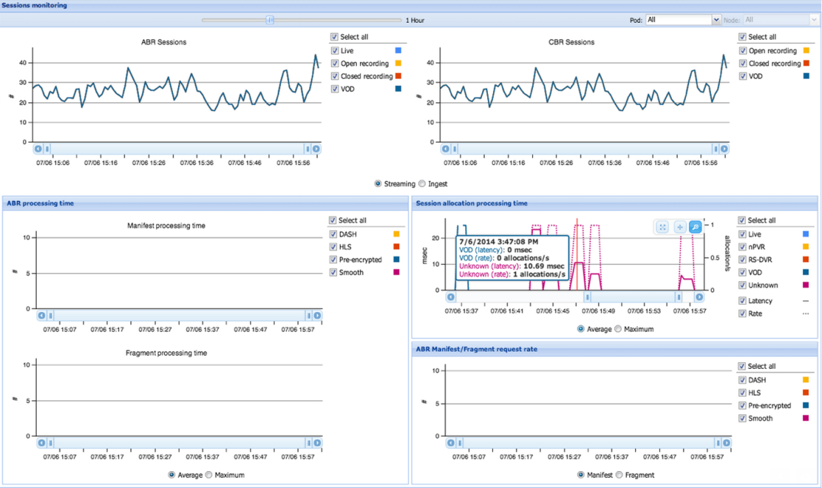
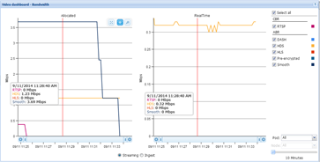
DashboaRDs
Out-of-the-box basic service-level monitoring solution
Part of the VSPP GUI
Static structure
Supports a small amount of basic views

Slide 84
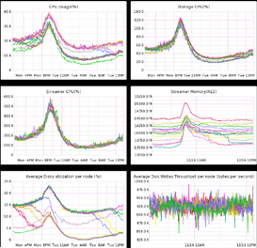
DashboaRDs – Cont’d
Graphite Dashboards: Visualization of Metrics - System and Service Level
Based on the continuously collated metric data
Seamless on the fly provisioning and customization of new graphs and views

Slide 85
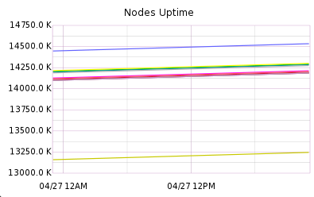
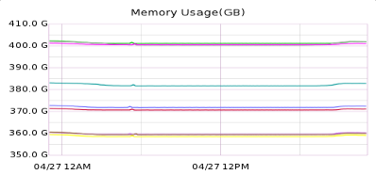
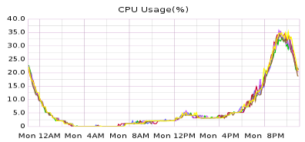
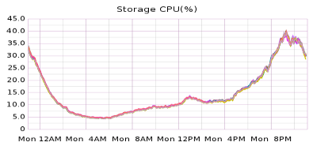
Graphite Examples

Slide 86
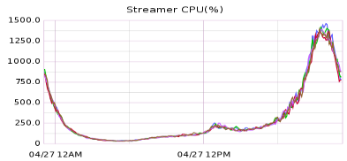
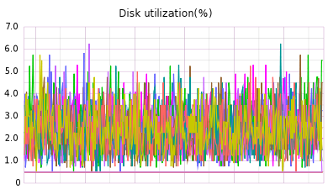
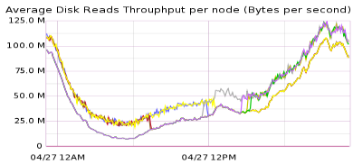
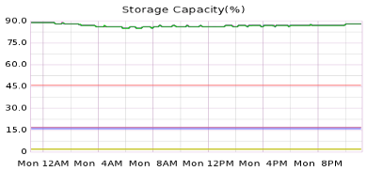
Graphite Examples

Slide 87
Reports
This feature enables performing an in depth business level system and a service level proactive analysis and monitoring of activities and exposes the following options:
Daily raw data CSV files generation and export to any external BI systems used on customer premises for the analysis activities:
SDRs and other file reports: session-based metrics and statistics
Mon-agent report: aggregated system level metrics
Out of the box reports, predefined reports start-packs as a installation packaged (vAPPs) for on-premises splunk based BI systems.
Diagnostics central, splunk based cloud environment
Enables tier-2 support for the E/// operational team to maintain stable production systems

Slide 88
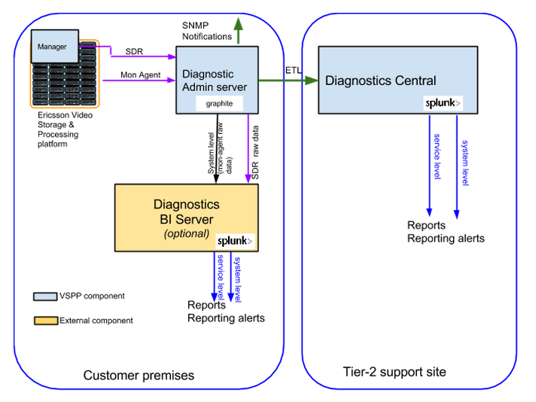
General Architecture
Mon-agent, VSPP in-house developed Python tool, runs on all the system nodes, collects different system/service level metrics and continuously reports them to the Diagnostics Admin server.
SDR, A raw data daily report containing different metrics on sessions managed by the system during the course of a day.

Slide 89
Diagnostics Admin Server
Centralized monitoring and diagnostics server (*)
Resides on customer premises and continuously collects data and metrics from the deployed systems
Exposes centralized SNMP interface and real-time notifications engine
Graphite dashboard - visualization of system and service level data analysis over time, based on the collected metrics.
Raw data files aggregation/extraction and ETL process
Stand alone component with no dependency on the VSPP SW version.
Recommended to install on VM cluster with the embedded HA technology for seamless scale out
* The HW/VM infrastructure to install on should be provided by the customer

Slide 90
Diagnostics – SUMMARY View
 | Real-time Monitoring | Dashboard | Offline Reports Services
Exposed Features | SNMP Monitoring Notifications: SNMP Traps, e-mails alerts | Out-of-box Video Dashboard Automatic populated Graphite | Daily Raw Data (CSV) export for any BI systems Splunk Reports Start-pack
Users | NOC Engineer | NOC Support Engineers VSPP Product Owner | NOC Business Analysts Support Engineers VSPP Product Owner
Available Professional Services | Configuration services - on alerts Training | Graphite Dashboard Customizations Training | Developing Customized Reports Proactive Tier-2 Monitoring Services
Required Hardware | Diagnostics Admin Server | Diagnostics Admin Server | Splunk Server for reports start-packs
Related Documentation Material (available in the Diagnostics Guide) | VSPP SNMP interface description (MIB) Real-time alerts list, description and default thresholds | Video Dashboard Manual Graphite Graphs and Dashboards | Raw data files description : Metric, Purpose, Data Structure Splunk Start-pack Reports (APPs) Installation Guidelines. Reports Description and Analyzing Approach

Slide 91
Resilience features of vspp

Slide 92
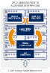
Features: manager
CLUSTERED STORAGE & GRID COMPUTING
In Memory
Database
Grid Manager
Provisioning
Element
TELEVISION
LIVE/REAL TIME
INTERNET
PC
CONTENT SOURCES
CONSUMER DEVICES
VOD
EXTERNAL CONTENT STORE
MOBILE
Storage Cluster
& Processing Grid
Storage Cluster
& Processing Grid
Storage Cluster
& Processing Grid
Storage Cluster
& Processing Grid

Slide 93
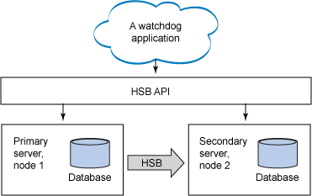
Soliddb hsb
HotStandby provides database resilience
PRIMARY ACTIVE
SECONDARY ACTIVE

Slide 94
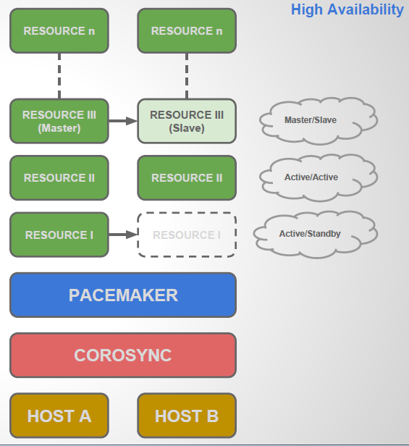
Cluster topology
Layered on standard Linux cluster technology
COROSYNC:
Maintain cluster membership
Transport Layer
Pacemaker:
Resource Manager
Maintains resource availability
Resource Layer

Slide 95
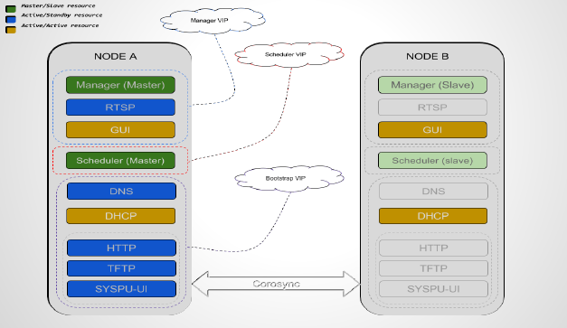
Cluster layout

Slide 96
Troubleshooting, Debugging Tools, and Logs

Slide 97
Log Files
All log files are located under /opt/Fabrix.TV/logs/ directory.
On the manager server you'll find the corresponding manager log, and
on the nodes themselves you'll be able to find streamer & storage log
files, concerning ingestion of videos and their playout.

Slide 98
How do we deal with Channel Issues
A very common error is “no data from source”, or otherwise “warnings from source”
In order to identify the problem (networking, actual no data, etc.) we'll have to try and capture the source (if available) and see if it's actually not coming through (no data) or has any issues by investigating it.

Slide 99
Checking Input Multicast - TCPDUMP
*tcp dump don’t send join IGMP messages
TCPDUMP utility is standard UNIX utility to capture network traffic
tcpdump -ni <multicast interface> host <multicast ip> -s0 -w /tmp/cores/capture.pcap
For Ex.
tcpdump -ni any host 239.0.32.12 and port 11115 -s0 -w /tmp/input.pcap -v
Wireshark is able to open the pcap file, then you should click ‘follow UDP stream’ and save it as TS file.
This should be done from the streamer node.

Slide 100
Checking Input Multicast - Join_MC
Same goal – only quicker!
JOIN_MC utility by Fabrix ← May not be installed on all systems
Will usually be located under /opt/Fabrix.TV/Util/
Usage: ./join_mc <ip> <port> <source> <if> <bytes_to_receive> [output_file]
For Example-
./join_mc -i 239.0.32.12 -p 11115 -s 0.0.0.0 -n eth2 -b 10000000 -w /tmp/layer.ts
join_mc is able to request igmp membership and save output as TS

Slide 101
How to Playout?
Static URL syntax for ABR playout – VOD-JIT
SMOOTH
http://$VIDEO_SERVER_DNS_NAME/shss/$ASSET_ID/$FRAGMENT_LENGTH.ism?start=0&end=-1&device=$DEVICE_PROFILE
For ex.
http://192.168.6.99:5555/shss/1420705142672/5.ism/Manifest?device=SMOOTH
HLS
http://$VIDEO_SERVER_DNS_NAME/shls/$ASSET_ID/$FRAGMENT_LENGTH.m3u8?start=0&end=-1&device=$DEVICE_PROFILE

Slide 102
Playout Logs
The playout will include the internal ID, which can be searched in the streamer log to see the entire session.
02/01/17 11:47:31.202 I S10.0.1.11 STREAM_OTT 0 @DMEAAAAACKMLBJIF FX_HTTP_HSS_Static_Streaming_Service_Data_Interface::on_http_request url=/shss/LIVE$11004/2.ism/manifest?start=2017-01-26T14:15:00Z&end=2017-01-26T16:09:00Z&device=mss_medium this=0x7f0728010100 con=0x7f072800f420
02/01/17 11:47:31.261 I S10.0.1.11 STREAM_OTT 0 @DMEAAAAACKMLBJIF FX_HTTP_Adaptive_Streaming_Base_Service::release_http_handler url=/shss/LIVE$11004/2.ism/manifest?start=2017-01-26T14:15:00Z&end=2017-01-26T16:09:00Z&device=mss_medium this=0x7f0728010100 con=0x7f072800f420 in_progress=1

Slide 103
Maintenance -
Replace/Repair Disks

Slide 104
Storage and Compute Grid Data recovery
In case of disk crash, the lost data is recovered using the parity chunk:
Machine protection: the segments chunks are divided across servers so that no 2 segment chunks reside on the same node.
rebuild
1
6
1
3
4
5
P
2
+ + + +
2
7
3
8
10 GbE Storage Nodes Interconnect
4
9
5
10
P
P

Slide 105


Storage and Compute Grid Self-healing and maintenance operations - Repair
Repair: the system will attempt to repair each missing/corrupted chunk by calculating it from its corresponding RAID chunks in the segment and write it back to the disk.
Repair is triggered when a read data check, or a data integrity check, finds a bad chunk:
STORAGE NODE 1
NEW
X
File 1
File 2
File 3
File 4
Free space
STORAGE NODE 2

Slide 106





Storage and Compute Grid Self-healing and maintenance operations - Rebuild
Rebuild: when the system detects a bad drive, or a by manual user operation, Rebuild operation is triggered.
The system rebuilds the failed drive with a many-to-many parallel IO operations. The chunks will be re-distributed to other drives and nodes according to the current permutation.
STORAGE NODE 1
STORAGE NODE 2
STORAGE NODE 3
X
File 1
File 2
File 3
File 4
Free space
STORAGE NODE 1
STORAGE NODE 2
STORAGE NODE 3
X
NEW
NEW
NEW
NEW

Slide 107
Storage and Compute Grid Self-healing and maintenance operations - Balance
Balance: When bad drives are replaced with new drives, the system is unbalanced and a balance operation is triggered.
The drive will be populated by file chunks from other drives and will bring the system to balanced state.
STORAGE NODE 1
STORAGE NODE 2
STORAGE NODE 3
File 1
File 2
File 3
File 4
Free space
STORAGE NODE 1
STORAGE NODE 2
STORAGE NODE 3
NEW

Slide 108
Storage and Compute Grid Self-healing and maintenance operations - Restripe
Restripe: When new storage attributes are added, the restripe mechanism will redistribute stored chunks into the newly added resources according to the new permutation.
STORAGE NODE 1
STORAGE NODE 2
STORAGE NODE 3
STORAGE NODE 3
+
File 1
File 2
File 3
File 4
Free space
STORAGE NODE 1
STORAGE NODE 2
STORAGE NODE 3
STORAGE NODE 3

